Slide 1
Distributed Data Pipeline

Slide 2
Data Gathering to Data Visualization

Slide 3
What is a Data Pipeline?
Data Pipeline is a methodology that separates compute from storage.
In other words, Pipeline is commonplace for everything related to data whether to ingest data, store data or to analyze that data.
Differentiating Big Data Pipeline and ETL
Sometimes, people get confused by two terms as some use cases use both As keywords interchangeably. But Both are, in fact, different as ETL (Extraction, Transformation and Load) is a subset of Data Pipeline Processing.
ETL is usually performed on Batches (here batch processing)
Data Pipeline contains both Batch and Real-Time Processing as Batch Engine and Real Time data processing Layer

Slide 4
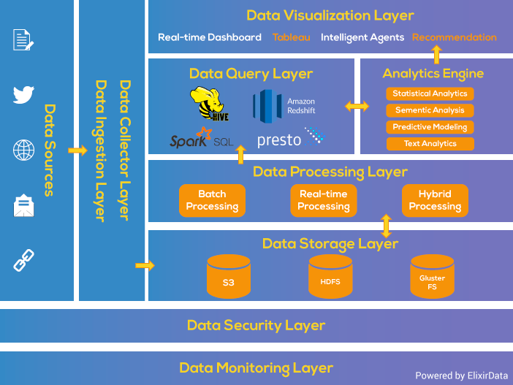
Architecture of Big Data Analytics
Data fusion and Integration
This Architecture helps in designing the data pipeline with the various requirements of either the Batch Processing System or Stream Processing System.
This architecture consists of 6 layers which ensure a secure flow of data.

Slide 5
Data Gathering
Big Data Architecture Layers
0. Data Gathering
Data ingestion layer
Data Collector layer
Data Processing Layer
Data Storage Layer
Data Query Layer
Data Visualization Layer

Slide 6
Data Gathering
The objective of the data gathering problem is to transmit the data from each node to a central point or distributed processing points.
The goal of algorithm which implement data gathering is
maximize the lifetime of network
Minimum energy should be consumed
The transmission occur with minimum delay

Slide 7
Data Aggregation
Redundant Data/events
Some services are amenable for in-network computations.
Communication can be more expensive than computation.
By performing “computation” on data en route to the sink/server/cloud, we can reduce the amount of data traffic in the network.
Increases energy efficiency as well as scalability
The bigger the network, the more computational resources.
Notes:
Point out how sensor networks relate to the are of distributed event-based systems, and make the case that the cost model here is primarily based on conserving energy. The process of publishing data has to be made as energy-efficient as possible and data-centric routing provides a mechanism for doing this. The basic idea is to permit intermediate nodes in the network to look at application-level information and perform aggregation on multiple input packets. We focus on simple aggregation schemes like duplicate suppression/min/max in this paper.

Slide 8
Data Fusion
Data fusion is an important concept in both big data, IoT and WSNs.
In the big data context,
the fusion is achieved at the computational platform
while in the WSNs context,
the fusion is performed inside the network (i.e. in-network process).
As one of the sources of the big data,
it is preferable to achieve in-network data fusion, so providing a unification of data representation and avoiding data explosion.
lead to saving the limited resources and capabilities/ resources.

Slide 9
Data Integration, Collection and Ingestion
Big Data Architecture Layers
Data ingestion layer
Data Collector layer
Data Processing Layer
Data Storage Layer
Data Query Layer
Data Visualization Layer

Slide 10
Data fusion and Integration

Slide 12
1. Data Ingestion Layer
Big Data Architecture Layers
Data ingestion layer
Data Collector layer
Data Processing Layer
Data Storage Layer
Data Query Layer
Data Visualization Layer
This layer is the first step for the data coming from variable sources to start its journey.
Data ingestion meaning the data here is prioritized and categorized which makes data flow smoothly in further layers in Data ingestion process flow.
2. Data Collector Layer
In this Layer, more focus is on the transportation of data from the ingestion layer to the rest of the data pipeline.
It is the Layer, where components are decoupled so that analytic capabilities may begin.

Slide 13
Data ingestion: Execution Models
Batch Processing
Interactive Processing (Online Processing)
Execution Models
Stream Processing
Real-time Processing
Parallel Processing

Slide 14
Batch Processing
Batch Processing: allows users to submit series of programs (jobs) and they will be executed to completion without further user input and manual intervention.
Is Hadoop a batch processing framework?
In better words, Hadoop is an open source distributed processing framework.
Hadoop Map-Reduce is best suited for batch processing.
Spark and Storm can be used for real time and stream processing.
Strom-Hadoop for real-time processing.
Notes:
-Spark is well-suited to machine learning algorithms has multi-stage in-memory primitives.
-One key difference between these two technologies is that Spark performs Data-Parallel computations while Storm performs Task-Parallel computations.
-Parameter sweep applications execute the same piece of code multiple times with unique sets of input parameters.
-HPC tasks need large amounts of computing power for short periods of time, whereas High Throughput Computing tasks also require large amounts of computing, but for much longer times (months and years, rather than hours and days).

Slide 15
Batch Processing
jobs that are parallel among which there are no dependencies. Jobs can be executed out of the submission order, such as video encoding/ decoding, etc.
At least more than 1012 floating point computations per sec.
Bag of Tasks
High Performance Computing jobs
to compose and execute a series of computational or data manipulation steps, or workflow, in a scientific application.
Scientific Workflows
Batch Processing
the analysis engine that adjusts the value of parameter by sweeping the parameter values through a user defined range.
Parameter Sweep Tasks
Map-Reduce Tasks
A programming model and an associated implementation for processing and generating big data sets with a parallel, distributed algorithm on a cluster
Graph Processing
where massive graphs (such as the web graph) are processed for information, and machine learning, where massive amounts of data are used to train models such as clustering algorithms and frequent pattern mining

Slide 16
Interactive (Online) Processing
Interactive Processing: Interactive computing refers to application which accepts input from humans, e.g., Web applications, Massively Multiplayer Online (MMO) games.
Online Processing: Another term for Interactive processing.
Interactive or online processing requires a user to supply an input.
Bar code scanning, online analytical processing (OLAP), online transaction processing (OLTP)
Stream Processing
Stream Processing: record-by-record analysis of machine data in motion, e.g., Sensor Networks analytics, Internet of things applications, Online video processing.
Characteristics
Compute Intensity
Data Parallelism
Data Locality
Notes:
OLAP computer-based technique of analyzing data to look for insights
OLTP facilitates and manages transaction-oriented applications typically for data entry and retrieval transaction processing.

Slide 17

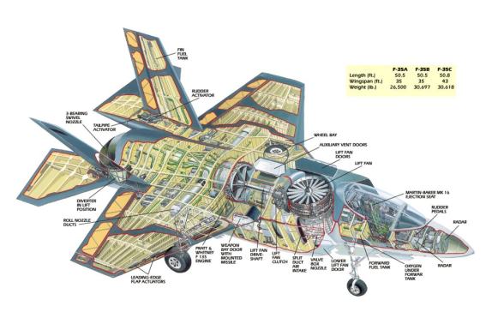
Real-time Processing
Real-time Processing: real time data processing involves a continual input, process and output of data. Data must be processed in a small time period (or near real time).
Hard real-time
Nuclear systems, avionics
Firm real time
Sound system
Soft real-time
Weather stations
Notes:
Soft real-time: Failure to meet a deadline is considered neither application nor system failure
OLAP is an approach to answering multi-dimensional analytical (MDA) queries swiftly
Real time processing is a subset of interactive or online processing. Online means that there is some kind of interactivity involved, but doesn't enforce limits in latency.

Slide 18
Real-time Processing vs. Stream Processing
There are no compulsory time limitations in stream processing while small guaranteed deadline is compulsory in real-time processing
Other examples:
airline ticket reservations, stock market, Fly-by-wire, antilock brakes, Videoconference applications, VoIP

Slide 19
Parallel Processing
is the processing of program instructions by dividing them among multiple processors with the objective of running a program in less time.
Concurrent computing vs. Parallel Processing
It is possible to have parallelism without concurrency (such as bit-level parallelism)- static or dynamic scheduling
Threading and multi threading
ILP and TLP and JLP
Notes:
A program consists of several parallelizable parts and several non-parallelizable (sequential) parts.

Slide 20
Data ingestion Challenges
Data Ingestion challenges
Slow Process
Complex and expensive
Vulnerable

Slide 21
Data Ingestion challenges
Slow Process
Complex and expensive
Vulnerable
Slow Process
Data ingestion is a slow process.
How?
When data is streamed from several different sources into the system, data coming from each & every different source has a different format, different syntax, attached metadata.
The data as a whole is heterogeneous.
It has to be transformed into a common format like JSON or something to be understood by the analytics system.
The conversion of data is a tedious process.
It takes a lot of computing resources & time.
Flowing data has to be staged at several stages in the pipeline, processed & then moved ahead.
Also, at each & every stage data has to be authenticated & verified to meet the organization’s security standards.
With the traditional data cleansing processes, it takes weeks if not months to get useful information on hand.

Slide 22
Data Ingestion challenges
Slow Process
Complex and expensive
Vulnerable
The conversion of data is a tedious process. It takes a lot of computing resources & time.
Flowing data has to be staged at several stages in the pipeline, processed & then moved ahead.
Complex & Expensive
There are always scenarios were the tools & frameworks available in the market fail to serve your custom needs & you are left with no option than to write a custom solution from the ground up
The semantics of the data coming from externals sources changes sometimes which then requires a change in the backend data processing code too.
The external IOT devices are evolving at a quick speed.
Data is Vulnerable
Then data is moved around it opens up the possibility of a breach.
Moving data is vulnerable.
It goes through several different staging areas & the development team has to put in additional resources to ensure their system meets the security standards at all times.

Slide 23
Data Ingestion Best Practices
Network Bandwidth: Data Pipeline must be able to compete with business traffic. Sometimes traffic increases or sometimes decreases, so Network bandwidth scalability is the biggest Data Pipeline challenge. Data ingestion tools are required for bandwidth throttling and compression capabilities.
Support for Unreliable Network: Data Ingestion Pipeline takes data with multiple structures, i.e., images, audios, videos, text files, tabular files data, XML files, log files, etc. and due to the variable speed of data coming, it might travel through the unreliable network. Data Pipeline should be capable of supporting this also. It is one of the most important Data ingestion best practices.
Heterogeneous Technologies and Systems: Tools for Data Ingestion Pipeline must be able to use different data sources technologies and different operating systems.

Slide 24
Data Ingestion Best Practices
Choose Right Data Format: Data ingestion tools must provide data serialization format, that means as data comes in the variable format so converting them into single format will provide an easier view to understand or relate the data.
Streaming Data: Data ingestion best practices are dependent upon business necessity whether to process the data in batch or streams or real-time. Sometimes we may require both processing in the data ingestion pipeline. So, tools must be capable of supporting both.
Maintain Scalability: Data ingestion best practices can be increased or decreased with time we can’t say for on Monday data will come less and the rest of the days comes a lot for processing. So, the usage of data is not uniform. What we can do is make our pipeline so scalable that it is able to handle any amount of data coming at variable speed.

Slide 25
Data Ingestion Best Practices
Connections: All the time data keeps on increasing in the Data ingestion framework, new data comes and old data modified, so, each new integration can take anywhere from a few days to a few months to complete.
High Accuracy: The only way to build trust with data consumers is to make sure that your data is auditable. One best practice that’s easy to implement is never to discard inputs or intermediate forms when altering data in Data ingestion process flow.
Latency: The fresher your data, the agiler your company’s decision-making can be. Extracting data from APIs and databases in real-time can be difficult, and many target data sources, including large object stores like Amazon S3 and analytics databases like Amazon Athena Redshift, are optimized for receiving data in chunks rather than a stream.

Slide 26
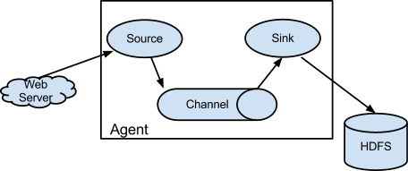
Big Data Ingestion Tools
https://flume.apache.org/
1. Apache Flume
Apache Flume is a distributed, reliable, and available service for efficiently collecting, aggregating, and moving large amounts of log data.
Functions of Apache Flume
Stream Data: Ingest streaming data from multiple sources into Hadoop for storage and analysis.
Insulate System: Buffer storage platform from transient spikes, when the rate of incoming data exceeds the rate at which data can be written to the destination
Scale Horizontally: For new Data ingestion streams and additional volume as needed.
Pull architecture
Point to point
Notes:
It has a straightforward and flexible architecture based on streaming data flows. It is robust and faults tolerant with tunable reliability mechanisms and many failovers and recovery mechanisms. It uses a simple, extensible big data security model that allows for an online analytic application and Data ingestion process flow.

Slide 27
Flume
Apache Flume is a distributed, reliable, and available service for efficiently collecting, aggregating, and moving large amounts of streaming data into the Hadoop Distributed File System (HDFS).
Notes:
Reference: http://hortonworks.com/hadoop/flume/

Slide 28
How flume works
Data flows like:
Agent tier -> Collector tier -> Storage tier
Agent nodes are typically installed on the machines that generate the logs and are data’s initial point of contact with Flume. They forward data to the next tier of collector nodes, which aggregate the separate data flows and forward them to the final storage tier.

Slide 29
Big Data Ingestion Tools
2. Apache Nifi
Apache Nifi is another one of the best Data ingestion tools that provide an easy to use, powerful, and reliable system to process and distribute data. Apache NiFi supports robust and scalable directed graphs of data routing, transformation, and system mediation logic.
Functions of Apache Nifi
Track data flow from beginning to end
The seamless experience between design, control, feedback, and monitoring
Secure because of SSL, SSH, HTTPS, encrypted content.
https://nifi.apache.org/
https://nifi.apache.org/quickstart.html

Slide 30
Distributed and Big Data Ingestion Tools
3. Elastic Logstash
Elastic Logstash is an open-source Data ingestion tool, server-side data processing pipeline that ingests data from a multitude of sources simultaneously transforms it, and then sends it to your “stash, ” i.e., Elasticsearch.
Functions of Elastic Logstash
Easily ingests from your logs, metrics, web applications, data stores
Multiple AWS services and done in continuous, streaming fashion
Ingest Data of all Shapes, Sizes, and Sources
https://www.elastic.co/logstash/

Slide 31
Data Ingestion: Challenges
As the number of IoT devices increases, both the volume and variance of Data Sources are expanding rapidly. So, extracting the data from the Data ingestion pipeline such that it can be used by the destination system is a significant challenge regarding time and resources.
Incorrect data ingestion can result in unreliable connectivity. This can disrupt communication and cause data loss.

Slide 32
Tips for Better Data Ingestion
Be capable enough to handle and upgrade the Data ingestion pipeline, new data sources, technology and applications
Assure that the consuming application is working with correct, consistent and trustworthy data to apply Data ingestion best practices.
Allows rapid consumption of data in Data ingestion process flow.
Capacity and reliability – The system needs to scale according to input coming and also it should be fault-tolerant.
Data volume – Though storing all incoming data is preferable; there are some cases in which aggregate data is stored.

Slide 33
Major Data Ingestion tools
Data Ingestion tools
Apache flume-
Streaming, buffer storage platform, scale horizontally
Apachey nifi-
data flow from ingestion to processing and data distribution, secure due to basic SSL, SSH, HTTPs encrypted content.
Elastic logstash-
ingest data from multiple sources, logs, web apps, data stores, ingest data of all shapes and sizes.

Slide 34
Big Data Processing Layer
Big Data Architecture Layers
Data ingestion layer
Data Collector layer
Data Processing Layer
Data Storage Layer
Data Query Layer
Data Visualization Layer

Slide 35
Data fusion and Integration

Slide 36
3. Data Processing Layer
Big Data Architecture Layers
Data ingestion layer
Data Collector layer
Data Processing Layer
Data Storage Layer
Data Query Layer
Data Visualization Layer
In this primary layer, the focus is to
specialize in the data pipeline processing system,
or
we can say the data we have collected in the previous layer is to be processed in this layer.
Here we do some magic with the data to route them to a different destination, classify the data flow and it’s the first point where the analytic may take place.

Slide 37
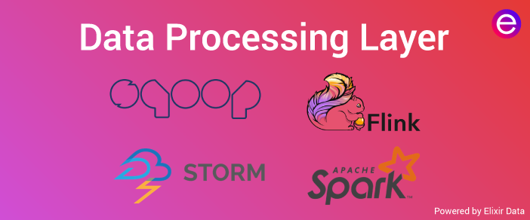
Data Processing tools
Big Data Batch Processing System is a simple batch processing system for offline analytics. For doing this tool used is Apache Sqoop.
Apache Sqoop (TM) is a tool designed for efficiently transferring bulk data between Hadoop and structured data stores such as relational databases.

Slide 38
What is Apache Sqoop?
It efficiently transfers bulk data between Apache Hadoop and structured datastores such as relational databases.
Apache Sqoop works with relational databases such as Teradata, Netezza, Oracle, MySQL, Postgres, and HSQLDB.
Functions of Apache Sqoop
Import sequential data sets from mainframe
Data imports
Parallel Data Transfer
Fast data copies
Efficient data analysis
Load balancing
https://sqoop.apache.org/

Slide 39
Near Real-Time Processing System
A pure online processing system for online analytics. For this type of processing Apache Storm is used. The Apache Storm cluster makes decisions about the criticality of the event and sends the alerts to the warning system (dashboard, e-mail, other monitoring systems).
https://storm.apache.org/
Apache Storm has many use cases:
Real time analytics,
online machine learning,
continuous computation,
distributed RPC, ETL, and more.
Apache Storm is fast: a benchmark clocked it at over a million tuples processed per second per node.
It is scalable, fault-tolerant, guarantees your data will be processed, and is easy to set up and operate.

Slide 40
What is Apache Storm?
It is a system for processing streaming data in real-time during Data ingestion. It adds reliable real-time data processing capabilities to Enterprise Hadoop. Storm on YARN is powerful for scenarios requiring real-time analytics, machine learning and continuous monitoring of operations.
Apache Storm integrates with any queuing system and any database system. Apache Storm's spout abstraction makes it easy to integrate a new queuing system. Example queue integrations include:
Kestrel
RabbitMQ / AMQP
Kafka
Amazon Kinesis
Likewise, integrating Apache Storm with database systems is easy. Simply open a connection to your database and read/write like you normally would. Apache Storm will handle the parallelization, partitioning, and retrying on failures when necessary.

Slide 41
What is Apache Spark?
Apache Spark optimization is a fast, in-memory data processing engine with elegant and expressive development APIs to allow data workers to efficiently execute streaming, machine learning or SQL workloads that require fast iterative access to data sets.
With Spark running on Apache Hadoop YARN, developers everywhere can now create applications to exploit Spark’s power, derive insights, and enrich their data science workloads within a single, shared data set in Hadoop

Slide 42
What is Apache Flink?
Apache Flink is an open-source framework in for distributed stream processing that Provides results that are accurate, even in the case of out-of-order or late-arriving data or Distributed Data Processing with Apache Flink.
Key Features of Apache Flink
Performs Data ingestion at large scale, running on thousands of nodes with excellent throughput and latency characteristics and Data ingestion framework.
It’s streaming data flow execution engine, APIs and domain-specific libraries for Batch, Streaming, Machine Learning, and Graph Processing.

Slide 43
Big Data Storage Layer
Big Data Architecture Layers
Data ingestion layer
Data Collector layer
Data Processing Layer
Data Storage Layer
Data Query Layer
Data Visualization Layer

Slide 44
Data fusion and Integration

Slide 45
4. Data Storage Layer
Big Data Architecture Layers
Data ingestion layer
Data Collector layer
Data Processing Layer
Data Storage Layer
Data Query Layer
Data Visualization Layer
Storage becomes a challenge when the size of the data you are dealing with, becomes large.
Several possible solutions like Data Ingestion Patterns can rescue from such problems.
This layer focuses on “where and how to store such large data efficiently.”

Slide 46
Big Data Storage Layer
The major issue in Data ingestion process flow is to keep data in the right place based on usage. We have relational Databases that were a successful place to store our data over the years.
But with the new big data analytics strategic enterprise applications, you should no longer be assuming that your persistence should be relational in Data ingestion.
Polyglot persistence is the idea of using multiple databases to power a single application.
Polyglot persistence is the way to share or divide your data into multiple databases and leverage their power together.

Slide 47
Advantages of Polyglot Persistence
Faster response times: Here we leverage all the features of databases in one app, which makes the response times of your app very quickly.
Helps your app to scale well: Your app scales exceptionally well with the data. All the NoSQL databases scale well when you model databases correctly for the data that you want to store.
A rich experience: You have a vibrant experience when you harness the power of multiple databases at the same time. For example, if you want to search for Products in an e-commerce app, then you use ElasticSearch, which returns the results based on relevance, which MongoDB cannot do.

Slide 48
Big Data Storage Tools
1. HDFS : Hadoop Distributed File System
HDFS is a Java-based file system that provides scalable and reliable data storage, and it was designed to span large clusters of commodity servers.
To store such massive data, the files are stored on multiple machines. These files are stored redundantly to rescue the system from possible data losses in case of failure.
HDFS also makes applications available for parallel processing in Data ingestion. HDFS is built to support applications with large data sets, including individual files that reach into the terabytes.
When HDFS takes in data, it breaks the information down into separate pieces and distributes them to different nodes in a cluster, allowing for parallel processing.
HDFS and YARN from the data management layer of Apache Hadoop in Data ingestion framework.

Slide 49
Big Data Storage Tools:
2. GlusterFS: Dependable Distributed File System
As we know a good storage solution must provide elasticity in both storage and performance without affecting active operations.
Scale-out storage systems based on GlusterFS are suitable for unstructured data such as documents, images, audio and video files, and log files.
GlusterFS is a scalable network filesystem.
It’s Open Source.
You can deploy GlusterFS with the help of commodity hardware servers.
Linear scaling of performance and storage capacity.
Scale storage size up to several petabytes, which can be accessed by thousands for servers.

Slide 50
Big Data Storage tools:
3. Amazon S3 Storage Service
Amazon Simple Storage Service (Amazon S3) is object storage with a simple web service interface to store and retrieve any amount of data from anywhere on the internet.
It is designed to deliver 99.999999999% durability, and scale past trillions of objects worldwide. Customers use S3 as primary storage for cloud-native applications; as a bulk repository, or “data lake,” for analytics; as a target for backup & recovery and disaster recovery; and with the serverless architecture of big data computing.
It’s simple to move large volumes of data into or out of S3 with Amazon’s cloud data migration options.
Once data is stored on Amazon S3, it can be automatically tiered into lower cost, longer-term cloud storage classes like S3 Standard – Infrequent Access and Amazon Glacier for archiving.

Slide 51
4. Cassandra
Cassandra is a distributed database management system that is used for handling large volumes of data across several servers. This is one of the most popular Big Data technologies which is preferred for processing structured data sets. It was first developed by Facebook as a NoSQL solution. It is now used by corporate giants, such as Netflix, Twitter and Cisco.
The most exciting features of Cassandra include:
It provides an easy to use query language, so it will be hassle-free if you want to transition from a relational database to Cassandra
Its Masterclass architecture allows data to be read and written on any node
Data is replicated on different nodes, so there is no single point of failure. Even if a node fails to work, data stored on other nodes will be available for use
Data can also be replicated across multiple data centres. So, if data is lost or damaged in one data centre, it can be retrieved from other data centres
It has built-in security features, such as restore mechanisms and data backup
This tool allows the detection and recovery of failed nodes

Slide 52
Big Data Query Layer
Big Data Architecture Layers
Data ingestion layer
Data Collector layer
Data Processing Layer
Data Storage Layer
Data Query Layer
Data Visualization Layer

Slide 53
Data fusion and Integration

Slide 54
5. Data Query Layer
Big Data Architecture Layers
Data ingestion layer
Data Collector layer
Data Processing Layer
Data Storage Layer
Data Query Layer
Data Visualization Layer
This is the layer where active analytic processing takes place.
Here, the primary focus is to gather the data value so that they are made to be more helpful for the next layer.
It is the layer where active analytic processing takes place. This is a field where interactive queries are necessary, and it’s a zone traditionally dominated by SQL expert developers. Before Hadoop, we had insufficient storage due to which it takes a long analytics process.
At first, it goes through a Lengthy process, i.e., ETL to get a new data source ready to be stored and after that, it puts the data in a database or data warehouse. But now, Data ingestion and data analytics became two essential steps that solved problems.

Slide 55
Apache Hive is a distributed, fault-tolerant data warehouse system that enables analytics at a massive scale.
A data warehouse provides a central store of information that can easily be analyzed to make informed, data driven decisions.
Hive allows users to read, write, and manage petabytes of data using SQL.
Hive is built on top of Apache Hadoop, which is an open-source framework used to efficiently store and process large datasets.
As a result, Hive is closely integrated with Hadoop, and is designed to work quickly on petabytes of data.
What makes Hive unique is the ability to query large datasets, leveraging Apache Tez or MapReduce, with a SQL-like interface.

Slide 56
Presto
is an open source distributed SQL query engine for running interactive analytic queries against data sources of all sizes ranging from gigabytes to petabytes.
Presto was designed and written from the ground up for interactive analytics and approaches the speed of commercial data warehouses while scaling to the size of organizations like Facebook.
Presto allows querying data where it lives, including Hive, Cassandra, relational databases or even proprietary data stores.
A single Presto query can combine data from multiple sources, allowing for analytics across your entire organization.

Slide 57
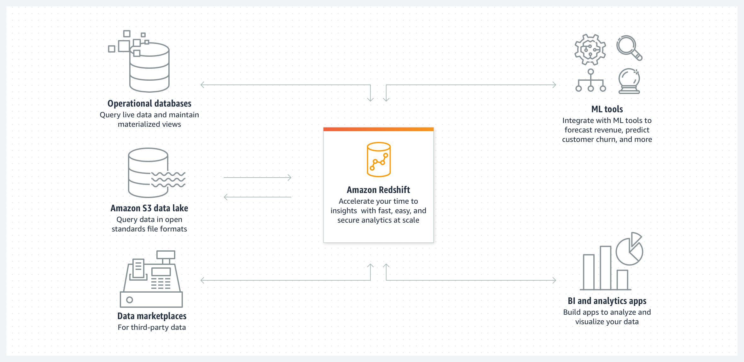
Amazon Redshift uses SQL to analyze structured and semi-structured data across data warehouses, operational databases, and data lakes, using AWS-designed hardware and machine learning to deliver the best price performance at any scale.

Slide 58
Big Data Visualization Layer
Big Data Architecture Layers
Data ingestion layer
Data Collector layer
Data Processing Layer
Data Storage Layer
Data Query Layer
Data Visualization Layer

Slide 59
Data fusion and Integration

Slide 60
6. Data Visualization Layer
Big Data Architecture Layers
Data ingestion layer
Data Collector layer
Data Processing Layer
Data Storage Layer
Data Query Layer
Data Visualization Layer
The visualization, or presentation tier, probably the most prestigious tier,
where the data pipeline users may feel the VALUE of DATA.
We need something that will grab people’s attention, pull them into, make your findings well-understood.

Slide 61
Tableau is a data visualization tool that can be used to create interactive graphs, charts, and maps. It allows you to connect to different data sources and create visualizations in minutes.
Tableau Desktop is the original product. It’s made for creating static visualizations that can be published on one or more web pages, but it doesn’t create interactive maps.
Tableau Public is the free distribution of the Desktop product with some limitations.
QlikView is not just another data visualization tool, It is a data discovery platform that empowers the users to make faster, more informed decisions by accelerating analytics, revealing new business insights, and increasing the accuracy of results.
It has been developed on a “drag and drops” visualization interface, allowing users to easily add data from many different sources, such as databases or spreadsheets, without having to write any code. These characteristics also make it a relatively easier tool to learn and grasp.
The Microsoft Power BI is the data visualization tool that is used for business intelligence type of data. It is and can be used for reporting, self-service analytics, and predictive analytics.

